Slide 1



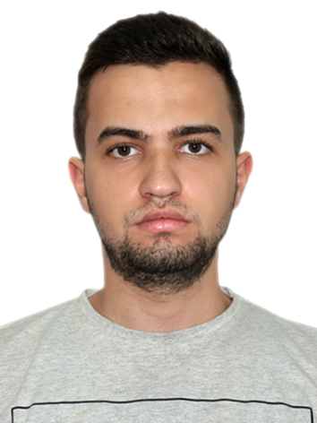
Kamran
Hajili
Flutter developer / Mechanical Engineer
ABOUT
I study mechanical engineer at BEU. And I have experience about programming field, specially in mobile development
PROFESSIONAL SKILLS
Technical background
Problem solving strategy
Mobile content development
Researching
Project management
WORK EXPERIENCE
Freelancer
Architecture and engineering, 3D modelling, 2D drawing
Generate accurate 3D models using data from 2D sketches
Solidworks, Surface modeling and Solid modeling techniques.
Tutor (trainer)
İTÜ 2019-2020
PERSONAL SKILLS
Physics and Mathematics
Autocad / SolidWorks (ITU)
Reliable and professional
Organized
Time management
Team player
Fast learner
Motivated
Freelancer
Flutter developer
Job Responsibilities:
Analyze user needs and develop software solutions
Work with project manager or product owner to meet specification needs
Recommend software upgrades to optimize operational efficiency
Collaborate with other developers to design and optimize code
Document all programming tasks and procedures
Perform routine software maintenance.
CONTACT
P: +994 777 333 003
E: khajili98@gmail.com
E: khacili@std.beu.edu.az
A: Baku (Azerbaijan)
EDUCATION
Baku Engineering University (Mechanical Engineering) 15/06/2016 - Present
Istanbul Technical University (İTÜ) 2019-2020
TDV-BTL 2013-2016
№91 School (Sabail, Baku) 2005-2013
SOCIAL
fb.me/ kamran880haciyev
Instagram/kamran_hajilii
AWARDS
"Technical drawing and 3D Mastercam" (Bilge Adam Bilişim Grubu İstanbul)
"CAD training" (Istanbul Technical University)
"Introduction to Programming with JavaScript" (Istanbul Technical University)
"Certified Python Trainings" (Istanbul Technical University)
Energy Hackathon 2020 winner (SOCAR AQS)
Enactus Azerbaijan 2020 Winter School

Slide 2
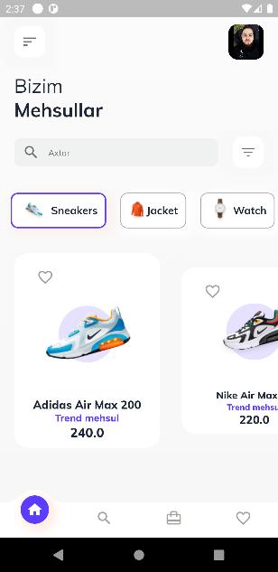
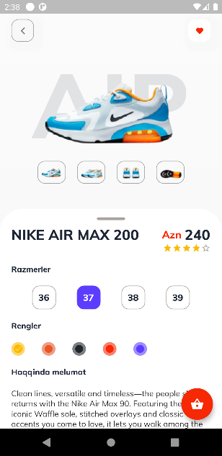
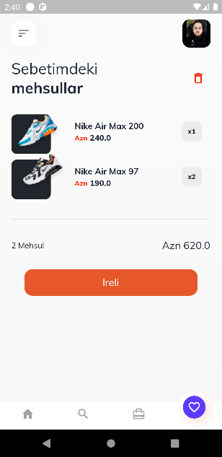
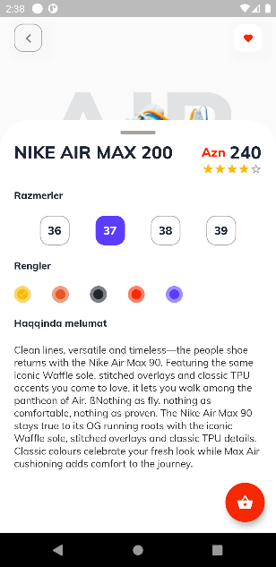
Shopping app
This mobile application is for E-commerce. Outfit sales are made through this application.
Searching, rating and filtering functionality is available on the mobile application.
Note app
The note application is designed to take your important notes.
Searching, flagging, sharing and CRUD (create, read, update and delete) functionality is available on the mobile application. Two theme options available on the mobile application :
Light and Dark theme.

Slide 3
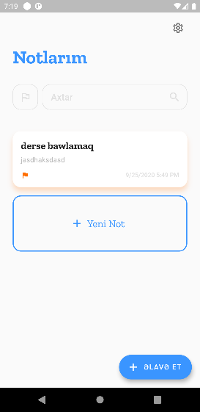
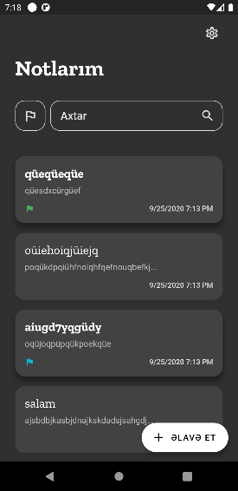
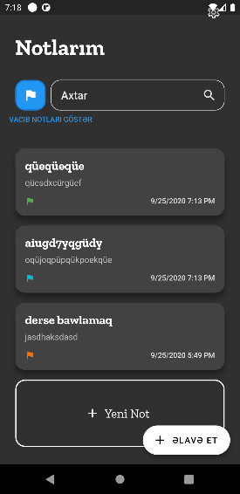
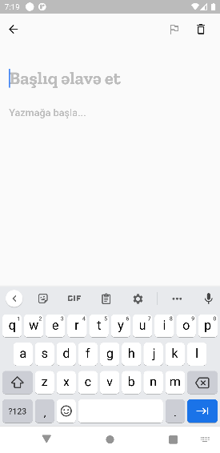
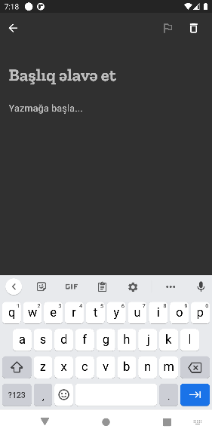
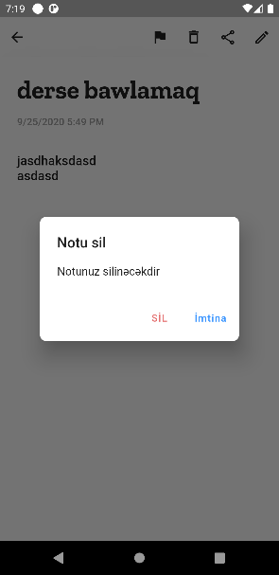
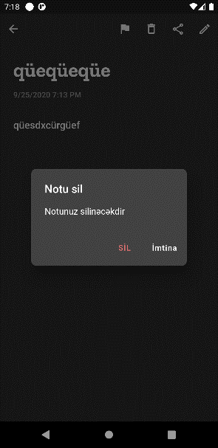
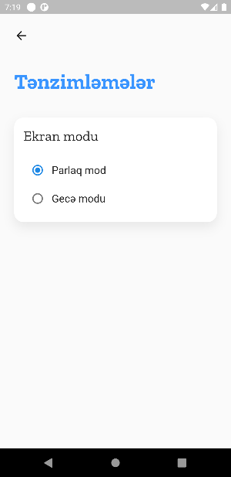
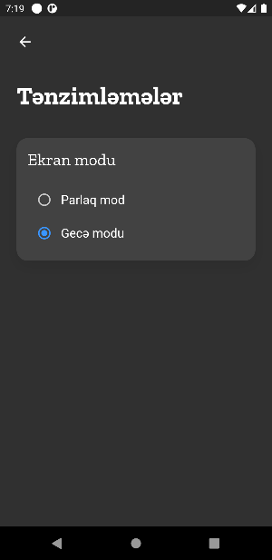
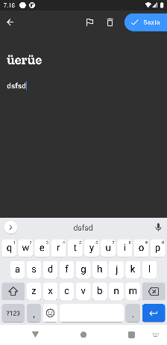
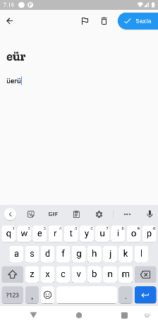
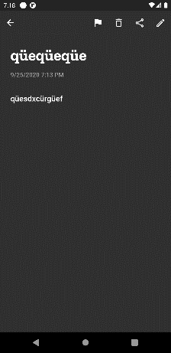
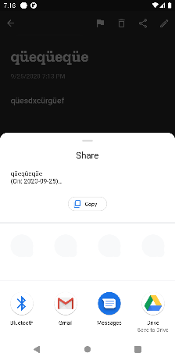
Note app

Slide 4
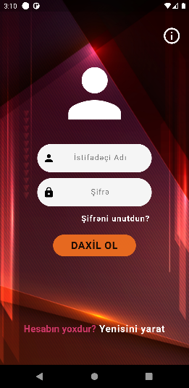
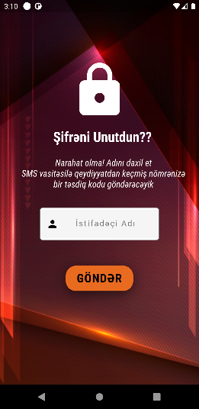
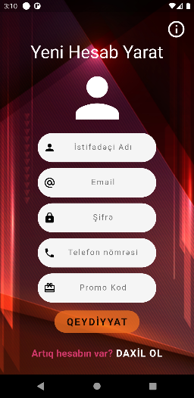
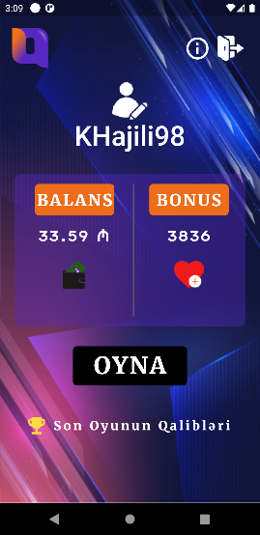
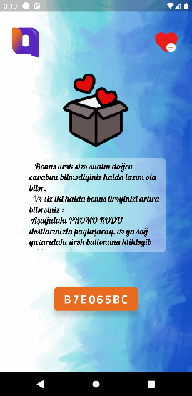
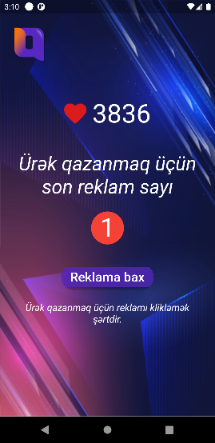
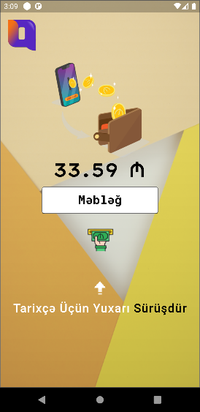
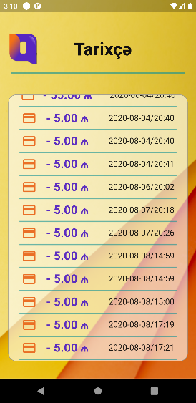
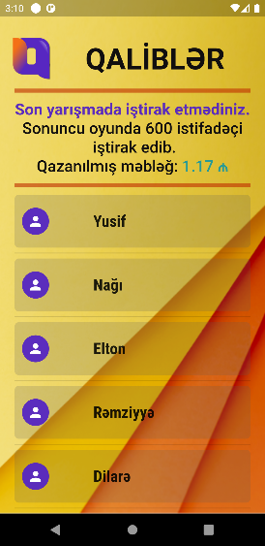
Trivia game app
Trivia game or competition is one where the competitors are asked questions about interesting but unimportant facts in many subjects and gain money.
App functionalities:
Two-factor auth
Forgot password
Promocode sharing
Multiple-Choice Questions
Open-ended questions
Closed-ended questions
More details:
SQLite DB
Back-end connection with Django (Python)
FCM notification (Firebase)
Admob - ads implementation
Real-time connection with server

